Slide 1
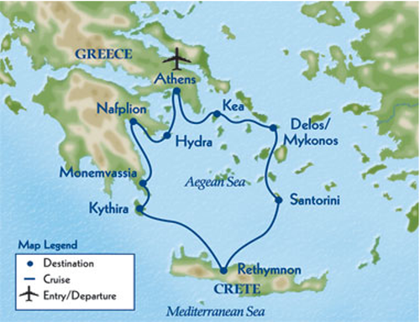
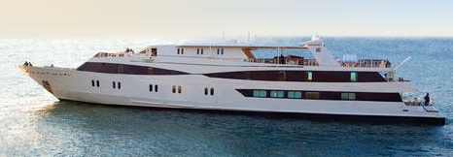
Classic Greek Isles Tour
An exciting and intimate 13 days in Greece and the Greek Isles
Begin

Slide 2
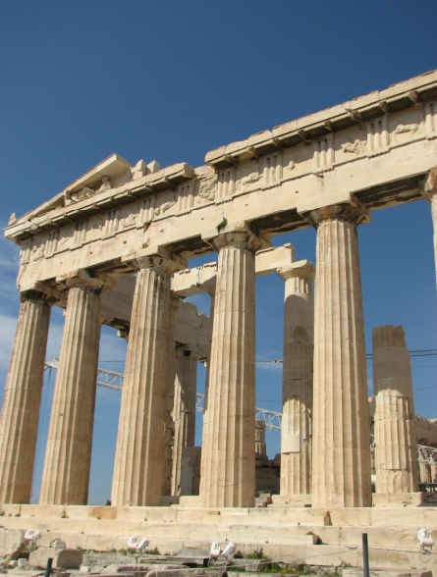
Menu
Tour Highlights
Itinerary
Trip Highlights
Harmony V Yacht

Slide 3
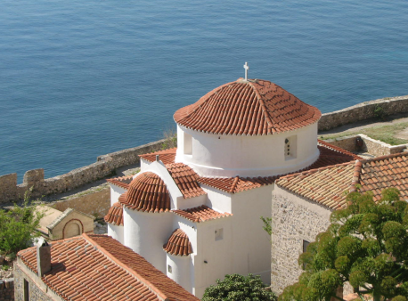
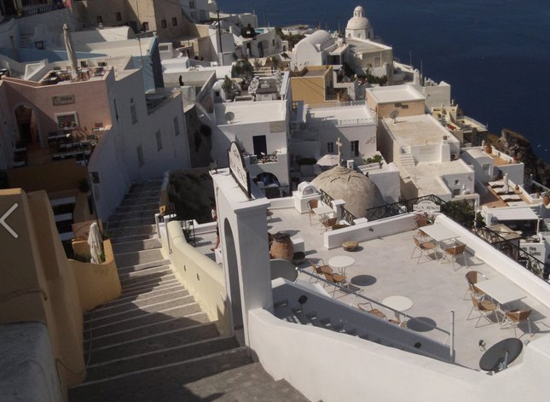
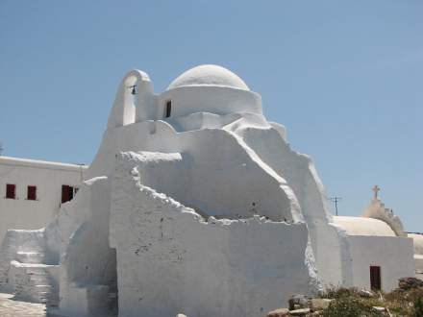
Tour Highlights
Seven-night Greek isles cruise aboard intimate mega-yacht
Casual, elegant onboard atmosphere
Athens touring, including Acropolis and Parthenon
Full-day excursion to ancient Delphi
Three included shore excursions: Delos’ important ruins; Palace of Knossos in Heraklion; Mycenae
Overnight stop in celebrated Mykonos
Picturesque Santorini
Venetian-tinged ­Rethymnon, Crete
Charming car-free Hydra
Opportunities for swimming and water sports from Harmony V
Ability to cruise to secluded harbors and hideaways
Back

Slide 4
Itinerary
Day 1: Depart U.S. for Athens, Greece
Day 2: Athens - A walking tour of Hermes Street and the lower Plaka district.
Day 3: Athens - Visit the city’s most important sites, including the 5th-century BCE Acropolis and Parthenon; and the renowned Acropolis Museum.
Day 4: Delphi - Travel today to central Greece to explore Delphi, the most beautiful and celebrated ancient site of all. Nestled between twin cliffs and spilling out onto the Sacred Plain.
Day 5: Athens/Cruising to Kea - Transfer to Athens’ port of Piraeus to board the mega-yacht Harmony V.
Day 6: Cruising to Delos/Mykonos - Call on the island of Delos, once the religious and political center of the Aegean, and today an important archaeological site devoid of ­inhabitants, as it has been for more than 2,000 years.
Day 7: Cruising to Santorini - Depart early this morning and enjoy a leisurely cruise to Santorini, the southernmost of the Cycladic islands.
Day 8: Cruising to Rethymnon, Crete - After reaching this port city today, we embark on an included private shore excursion to ancient Knossos.
Day 9: Cruising to Kythira - Enjoy a relaxed swim stop late morning then cruise to the island of Kythira, nestled at the foot of the Peloponnese between the Ionian and Aegean seas.
Day 10: Cruising to Monemvassia/Nafplion ­ Having cruised through the night, this morning we reach the Peloponnese region on the Greek mainland.
Day 11: Cruising to Mycenae/Hydra - The imposing ruins at Mycenae represent the pinnacle of Mycenaean civilization, dating from the 15th to 12th centuries BCE.
Day 12: Cruising to Piraeus/Athens - We disembark this morning and transfer to Athens, where we tour the acclaimed Benaki Museum.
Day 13: Depart for U.S. Early this morning we transfer to the airport, where we connect with our flights home.
Back

Slide 5
Trip Highlights
Click the blue dots that are circled in white on the map to get information some of your destinations.
Back

Slide 6
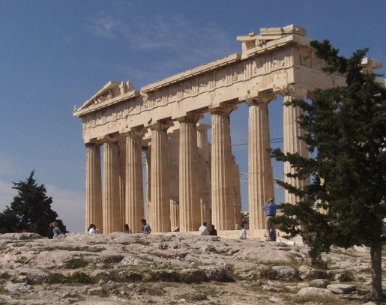
Trip Highlights
Athens
One of the city’s most important sites, the Acropolis and Parthenon.
Click anywhere to return.

Slide 7
Trip Highlights
Athens
One of the city’s most important sites, the Acropolis and Parthenon.

Slide 8
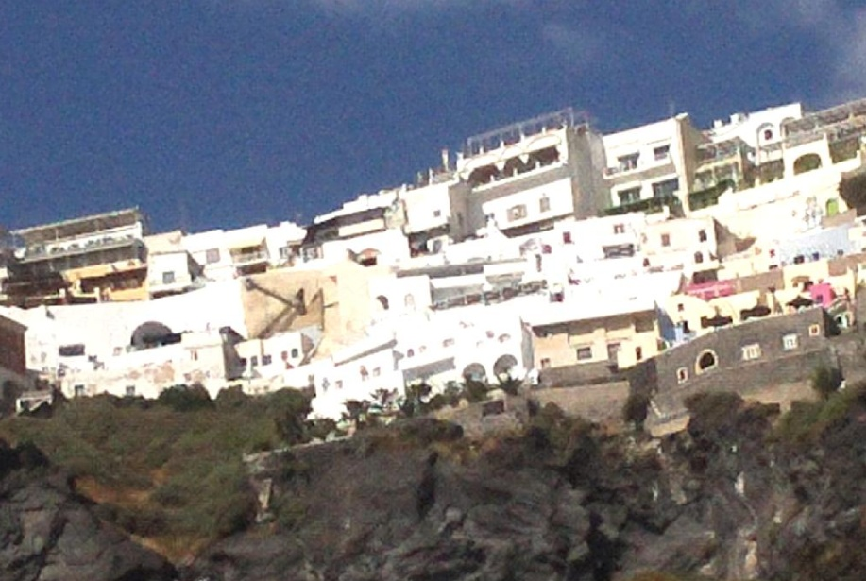
Trip Highlights
Santorini
The southernmost of the Cycladic islands. Santorini today attracts both Greeks and visitors alike with its stupendous setting of whitewashed villages sitting atop the jagged cliffs.
Click anywhere to return.

Slide 9
Trip Highlights
Santorini
The southernmost of the Cycladic islands. Santorini today attracts both Greeks and visitors alike with its stupendous setting of whitewashed villages sitting atop the jagged cliffs.

Slide 10
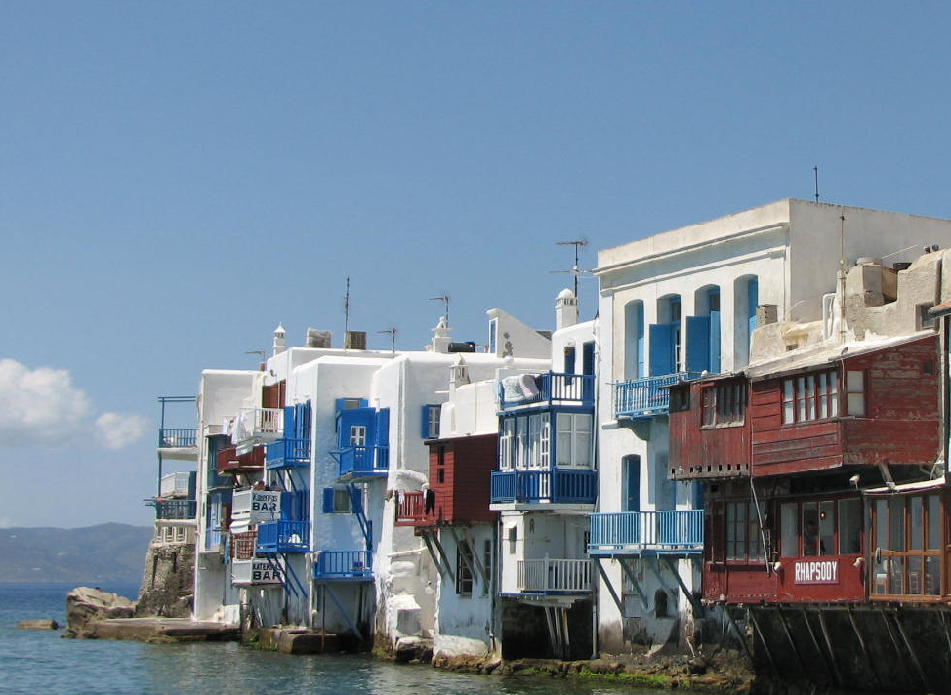
Trip Highlights
Mykonos
In Greek mythology Mykonos was the location of the battle between Zeus and the Titans.
Click anywhere to return.

Slide 11
Trip Highlights
Mykonos
In Greek mythology Mykonos was the location of the battle between Zeus and the Titans.

Slide 12
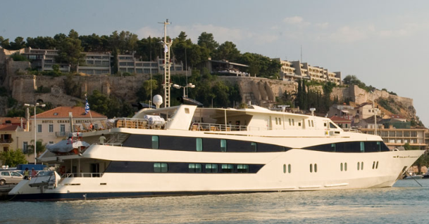
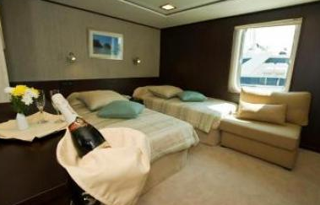
Harmony V Yacht
Click the image to get more information and a view of one of the cabins.
HARMONY V is a newly refitted, gorgeous mega-yacht that can accommodate 49 passengers, making her ideal for the larger charter party. There are 25 cabins with private facilities en suite and individually controlled air conditioning. All cabins have large windows, flat screen TV sets, DVD players, music channels, mini fridges and hairdryers, making for all the comforts of home at sea. The spacious lounge offers comfortable seating, a bar and an adjoining dining room with big windows looking out to beautiful views of the passing scenery. The dining room can accommodate all guests in one seating and offers the highest standard of fine cuisine. There is also a lovely area on deck where meals can be had al fresco, surrounded by the gorgeous blue waters.
Back

